Slide 1
CURE
Clustering using representatives

Slide 2
Clustering using representatives
Clustering, in data mining, is useful for discovering groups and identifying interesting distributions in the underlying data.
Traditional clustering algorithms either favor clusters with spherical shapes and similar sizes, or are very fragile in the presence of outliers.
There is a new clustering algorithm called CURE that is more robust to outliers, and identifies clusters having non-spherical shapes and wide variances in size. CURE achieves this by representing each cluster by a certain fixed number of points that are generated by selecting well scattered points from the cluster and then shrinking them toward the center of the cluster by a specified fraction. Having more than one representative point per cluster allows CURE to adjust well to the geometry of non-spherical shapes and the shrinking helps to dampen the effects of outliers.
To handle large databases, CURE employs a combination of random sampling and partitioning. A random sample drawn from the data set is first partitioned and each partition is partially clustered. The partial clusters are then clustered in a second pass to yield the desired clusters.
CURE scale well for large databases without sacrificing clustering quality.

Slide 3
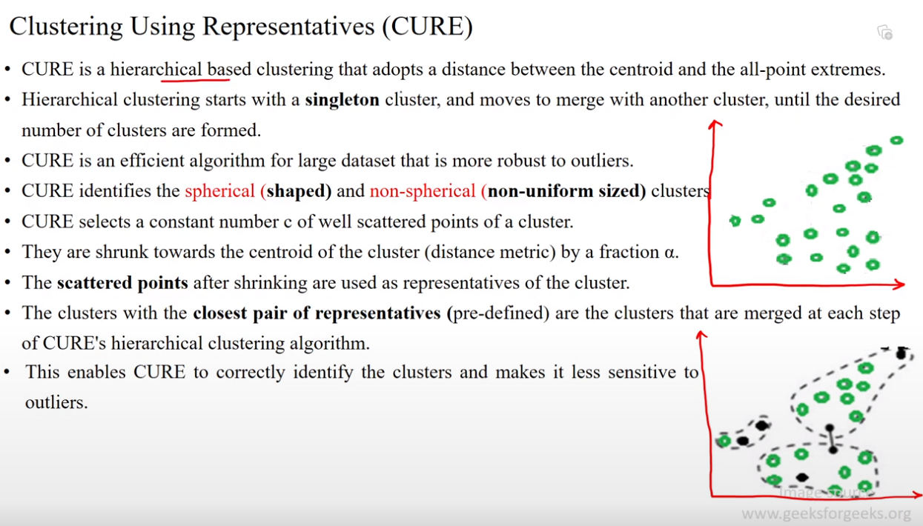

Slide 4
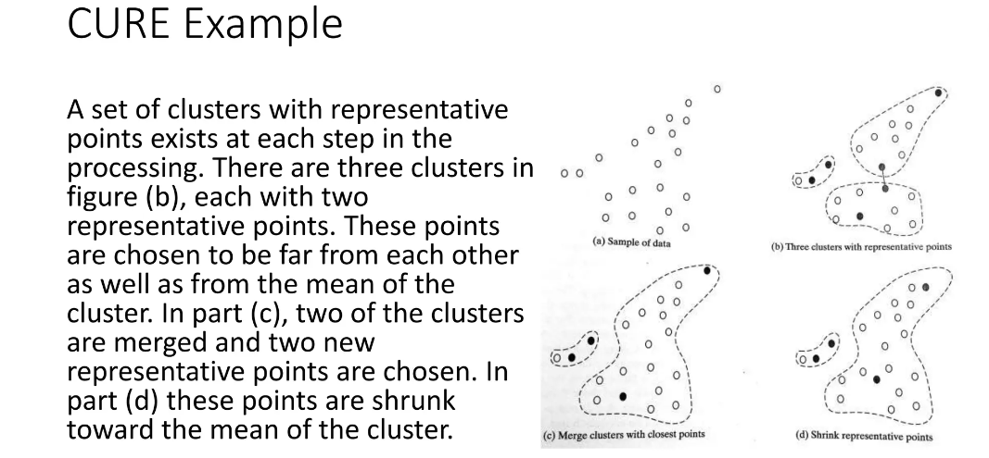

Slide 5
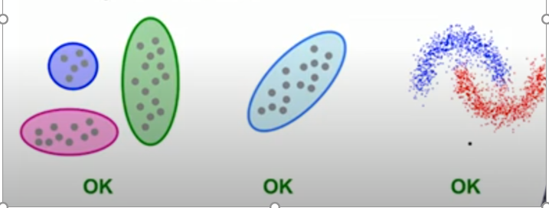
CURE ( Clustering Using Representatives
Assumes Euclidean distance
Assumes clusters to assume any shape
Use a collection of representative points to represent clusters.

Slide 6
CURE works in 2 different passes (phases)
Pass 1 of 2
Pick a random sample of points that fit in main memory.
Cluster sample points hierarchically to create the initial clusters.
Pick representative points:
For each cluster, pick k (eg. 4) representative points, as dispersed as possible.
Move each representative point a fixed fraction (eg. 20% ) towards the centroid of the cluster.

Slide 7
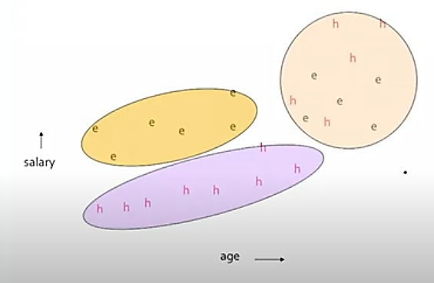
Clustering using Hierarchical clustering by sampling the data points from a large datasets
H: humanities faculty
E: engineering faculty

Slide 8
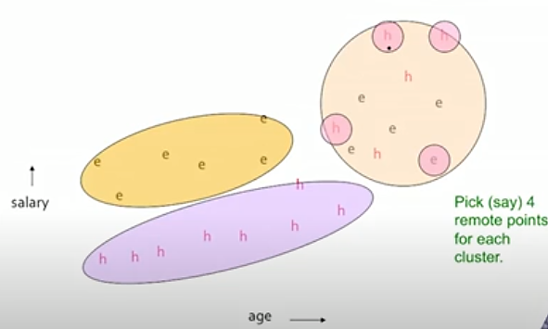
Choose cluster representatives in every cluster: depicted by small rounds

Slide 9
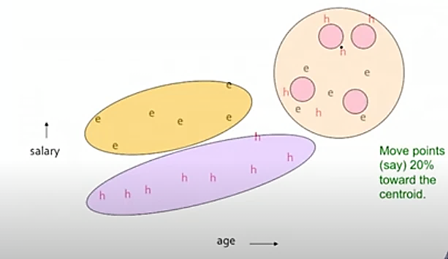
Shrink the cluster representatives closer to the centroid, do for all clusters. Here its shown for only pink cluster
Synthetic points

Slide 10
Pass 2 of 2
Now, rescan the whole dataset and visit each p in the dataset
Place it in the closest cluster
Normal definition of “closest” : is that cluster with the closest (to p) among all the representative points of all the clusters

Slide 11
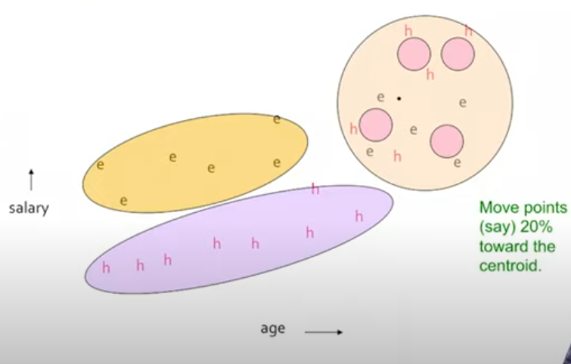
Cluster 3
Cluster 1
New point will be assigned to cluster 3 as its near to the cluster 3 representative.
New point
Cluster 2

Slide 12
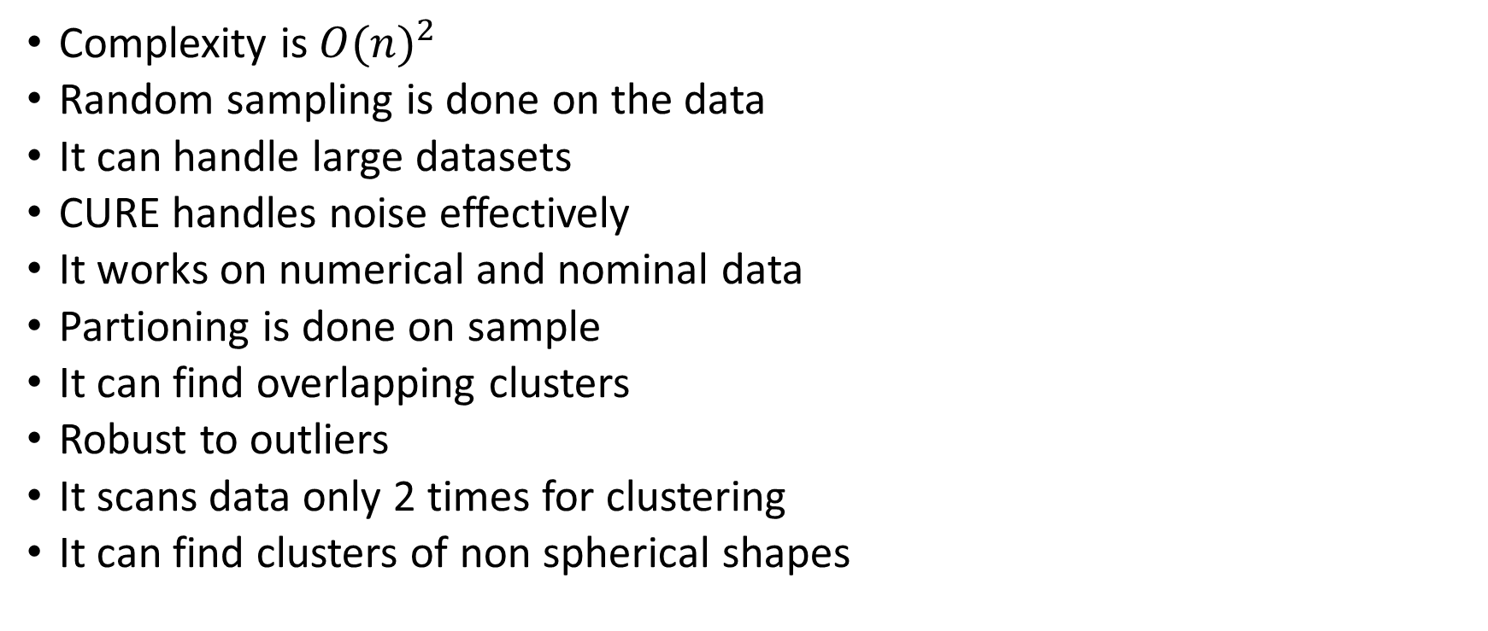
Features of CURE
Complexity is${ O(n)}^{2}$
Random sampling is done on the data
It can handle large datasets
CURE handles noise effectively
It works on numerical and nominal data
Partioning is done on sample
It can find overlapping clusters
Robust to outliers
It scans data only 2 times for clustering
It can find clusters of non spherical shapes

Slide 13
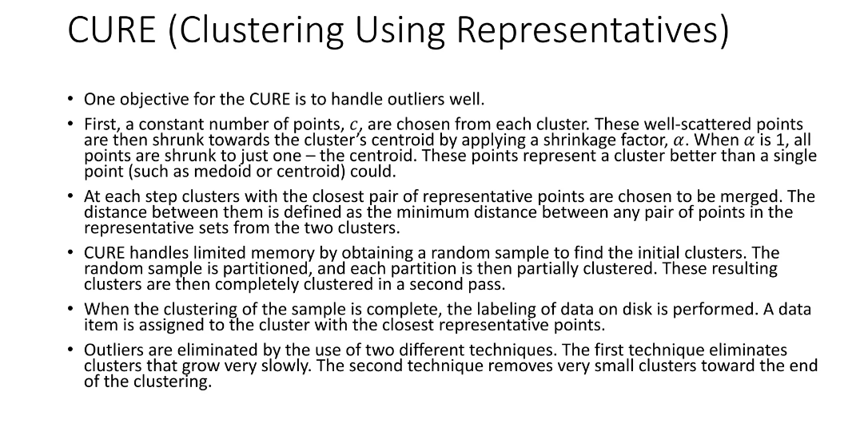

Slide 15
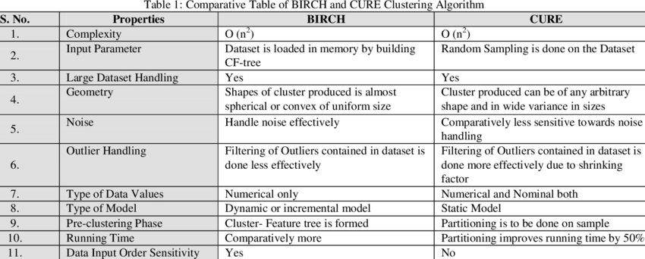
time

Slide 16
(Clustering Using Representatives)
It is a hierarchical based clustering technique, that adopts a middle ground between the centroid based and the all-point extremes. Hierarchical clustering is a type of clustering, that starts with a single point cluster, and moves to merge with another cluster, until the desired number of clusters are formed.
It is used for identifying the spherical and non-spherical clusters.
It is useful for discovering groups and identifying interesting distributions in the underlying data.
Instead of using one point centroid, as in most of data mining algorithms, CURE uses a set of well-defined representative points, for efficiently handling the clusters and eliminating the outliers.

Slide 17
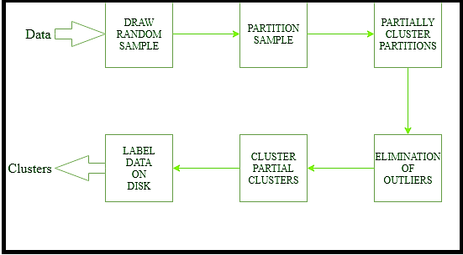
Flow diagram of CURE

Slide 18
Reference
Lecture 62 — The CURE Algorithm (Advanced) | Stanford University – YouTube
96 CURE Clustering Algorithm - YouTube

